Slide 1
Fundamentals of Programming
Functions

Slide 2
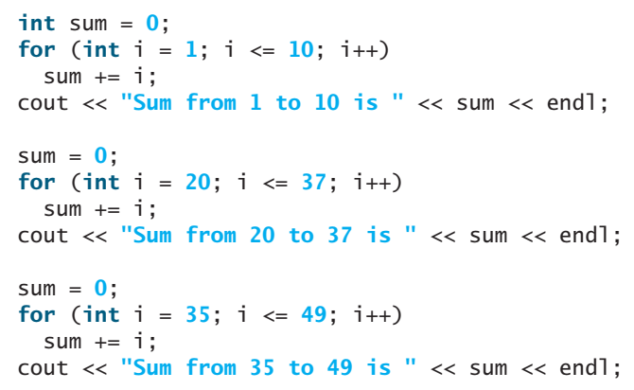
Introduction
Functions can be used to
define reusable code
organize and simplify code
Find sum of integers from 1 to 10, 20 to 37, and 35 to 49

Slide 3
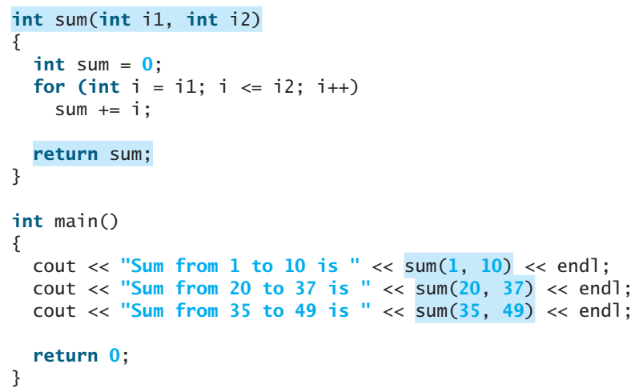
Introduction
Observation: computing these sums from 1 to 10, from 20 to 37, and from 35 to 49 are very similar except that the starting and ending integers are different.
If we could write the common code once and reuse it?
Return Type
Body
Parameters
Name

Slide 4
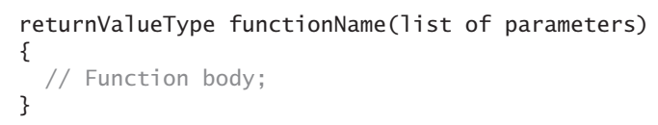
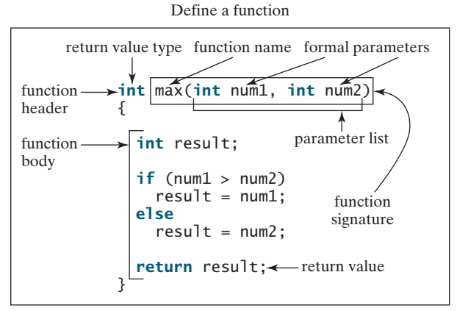
Defining a Function
function name, parameters, return value type, and body
Invoke Fn
int x = max(5,8);
int y = max(9,7);

Slide 5
Defining a Function
A function may return a value. The returnValueType is the data type of that value.
Some functions perform desired operations without returning a value. In this case, the returnValueType is the keyword void.
The function that returns a value is called a value-returning function and the function that does not return a value is called a void function
void printLine()
{
for(int a=0;a<50;a++)
cout<<“*”;
}

Slide 6
Defining a Function
The variables declared in the function header are known as formal parameters or simply parameters.
A parameter is like a placeholder. When a function is invoked, you pass a value to the parameter. This value is referred to as an actual parameter or argument.
The parameter list refers to the type, order, and number of the parameters of a function.
The function name and the parameter list together constitute the function signature. Parameters are optional; that is, a function may contain no parameters.
void printLine()
{
for(int a=0;a<50;a++)
cout<<“*”;
}

Slide 7
Defining a Function
The function body contains a collection of statements that define what the function does.
The function body of the max function uses an if statement to determine which number is larger and returns the value of that number.
A return statement using the keyword return is required for a value-returning function to return a result.
The function exits when a return statement is executed.
int Max(int n1, int n2)
{
if(n1 > n2)
return n1;
else
return n2;
}

Slide 8
Calling a Function
Calling a function executes the code in the function
In creating a function, you define what it should do. To use a function, you have to call or invoke it.
There are two ways to call a function, depending on whether or not it returns a value.
If the function returns a value, a call to that function is usually treated as a value. For example,
int larger = max(3, 4);
calls max(3, 4) and assigns the result of the function to the variable larger. Another example of such a call is
cout << max(3, 4);
which prints the return value of the function call max(3, 4)

Slide 9
Calling a Function
A value-returning function can also be invoked as a statement in C++. In this case, the caller simply ignores the return value. This is not often done, but it is permitted if the caller is not interested in the return value.
max(3, 4);
When a program calls a function, program control is transferred to the called function. The called function is executed. A called function returns control to the caller when its return statement is executed or when its function-ending closing brace is reached.
The main function is just like any other function except that it is invoked by the operating system to execute the program. All other functions must be executed by function call statements.

Slide 10
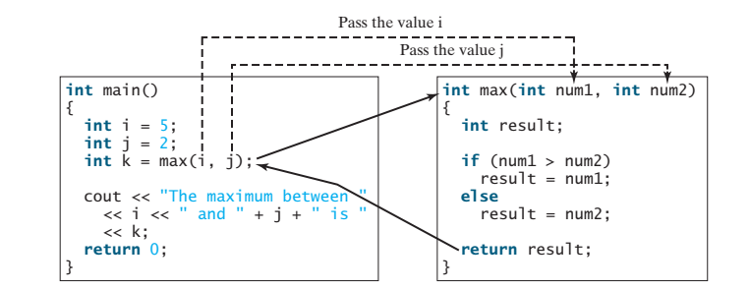
Calling a Function
When the max function is invoked, variable i’s value 5 is passed to num1, and variable j’s value 2 is passed to num2 in the max function. The flow of control transfers to the max function. The max function is executed. When the return statement in the max function is executed, the max function returns the control to its caller (in this case the caller is the main function)

Slide 11
Calling a Function
Each time a function is invoked, the system creates an activation record (also called an activation frame) that stores its arguments and variables for the function and places the activation record in an area of memory known as a call stack.
A call stack is also known as an execution stack, runtime stack, or machine stack, and is often shortened to just “the stack.”
When a function calls another function, the caller’s activation record is kept intact and a new activation record is created for the new function call.
When a function finishes its work and returns control to its caller, its activation record is removed from the call stack.

Slide 12
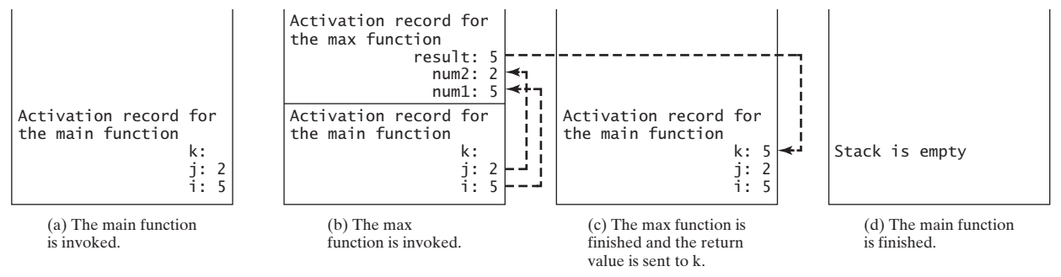
Calling a Function
A call stack stores the activation records in a last-in, first-out fashion. The activation record for the function that is invoked last is removed first from the stack

Slide 13
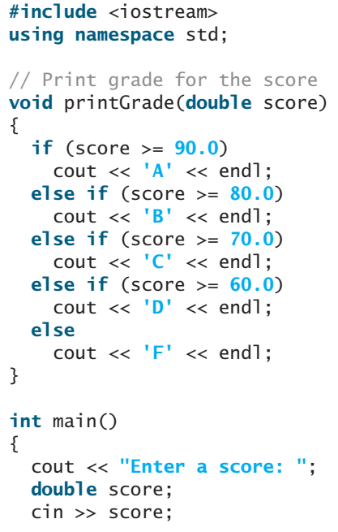
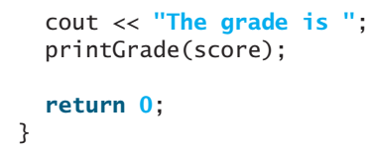
void Functions
A void function does not return a value.
The printGrade function is a void function. It does not return any value.
A call to a void function must be a statement

Slide 14
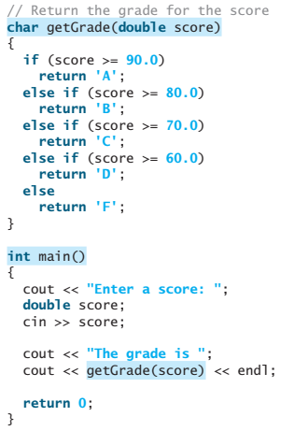
void Functions
void and value-return function

Slide 15
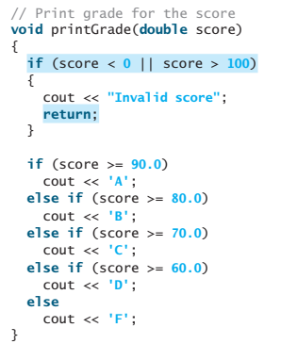
void Functions
Return for Void functions

Slide 16
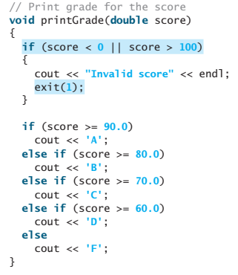
void Functions
Occasionally you may need to terminate the program from the function immediately if an abnormal condition occurs. This can be done by invoking the exit(int) function defined in the cstdlib header. You can pass any integer to invoke this function to indicate an error in the program. For example, the following function terminates the program if an invalid score is passed to the function.

Slide 17
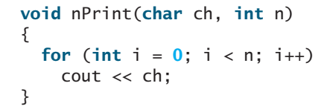
Passing Arguments by Value
By default, the arguments are passed by value to parameters when invoking a function.
The power of a function is its ability to work with parameters. You can use max to find the maximum between any two int values. When calling a function, you need to provide arguments, which must be given in the same order as their respective parameters in the function signature. This is known as parameter order association. For example, the following function prints a character n times:

Slide 18

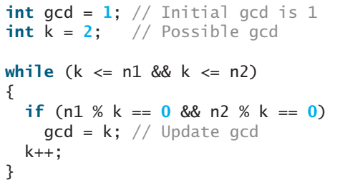
Modularizing Code
Modularizing makes the code easy to maintain and debug and enables the code to be reused.
Functions can be used to reduce redundant code and enable code reuse.
Following code calculates GCD of two numbers

Slide 19
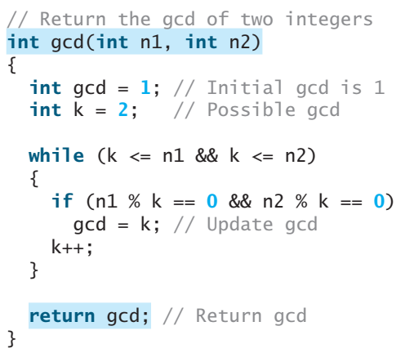
Modularizing Code
When implemented in a function

Slide 20
Modularizing Code
By encapsulating the code for obtaining the GCD in a function, this program has several advantages:
It isolates the problem for computing the GCD from the rest of the code in the main function. Thus, the logic becomes clear and the program is easier to read.
If there are errors on computing GCD, they will be confined in the gcd function, which narrows the scope of debugging.
The gcd function now can be reused by other programs.
Study Prime Numbers code from section 6.6 of course book

Slide 21
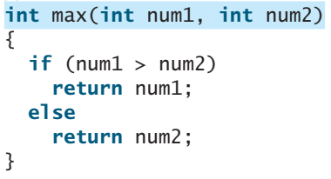
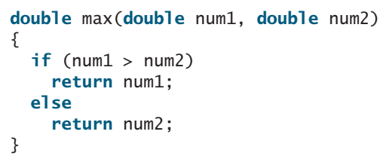
Overloading Functions
enables you to define the functions with the same name as long as their signatures are different.
The max function that was used earlier works only with the int data type. But what if you need to determine which of two floating-point numbers has the larger value?
If you call max with int parameters, the max function that expects int parameters will be invoked; if you call max with double parameters, the max function that expects double parameters will be invoked.

Slide 22
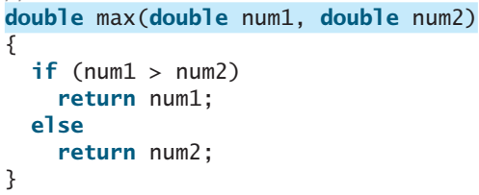
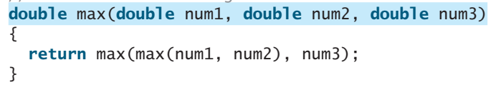
Overloading Functions
Three functions with same name but different parameters
Calls
max(3,4); max(15.6,7.2); max(1,2.5,3.1);
Write max function to find largest of four integers?

Slide 23
Overloading Functions
can make programs clearer and more readable. Functions that perform the same task with different types of parameters should be given the same name.
must have different parameter lists. You cannot overload functions based on different return types.
Is it VALID?
int Max(int n1, int n2)
{
if(n1 > n2)
return n1;
else
return n2;
}
double Max(int n1, int n2)
{
if(n1 > n2)
return n1;
else
return n2;
}

Slide 24
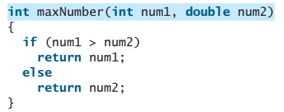
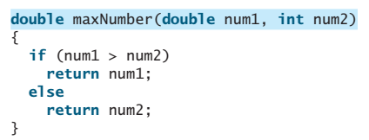
Overloading Functions
Sometimes there are two or more possible matches for an invocation of a function, and the compiler cannot determine the most specific match. This is referred to as ambiguous invocation. Ambiguous invocation causes a compile error.
maxNumber(1, 2)
Both maxNumber(int, double) and maxNumber(double, int) are possible candidates to match maxNumber(1, 2).
change maxNumber(1, 2) to maxNumber(1, 2.0), it will match the first maxNumber function

Slide 25
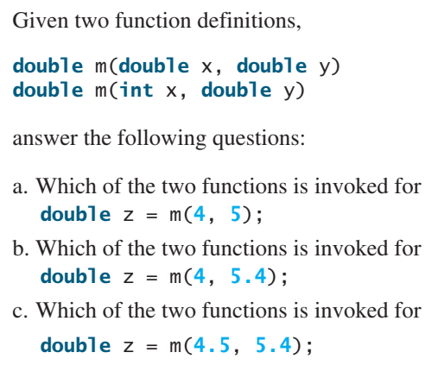
Overloading Functions

Slide 26


Function Prototypes
declares a function without having to implement it.
In the prototype, you need not list the parameter names, only the parameter types. C++ compiler ignores the parameter names. The prototype tells the compiler the name of the function, its return type, the number of parameters, and each parameter’s type.
Declaring a function specifies what a function is without implementing it. Defining a function gives a function body that implements the function

Slide 27
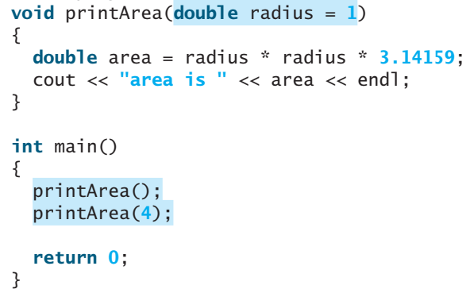
Default Arguments
C++ allows default values for parameters in a function
If a function is declared with default argument values, The default values are passed to the parameters when a function is invoked without the arguments.

Slide 28


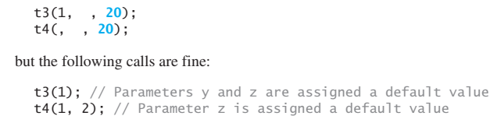
Default Arguments
When a function contains a mixture of parameters with and without default values, those with default values must be declared last. For example,
When an argument is left out of a function, all arguments that come after it must be left out as well. For example, the following calls are illegal:

Slide 29
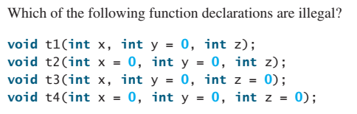
Default Arguments

Slide 30
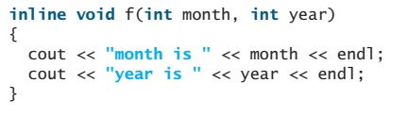
Inline Functions
inline functions improve performance for short functions
Implementing a program using functions makes the program easy to read and easy to maintain, but function calls involve runtime overhead (i.e., pushing arguments and CPU registers into the stack and transferring control to and from a function). C++ provides inline functions to avoid function calls. Inline functions are not called; rather, the compiler copies the function code in line at the point of each invocation. To specify an inline function, precede the function declaration with the inline keyword

Slide 31
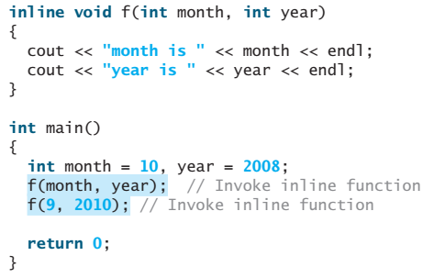
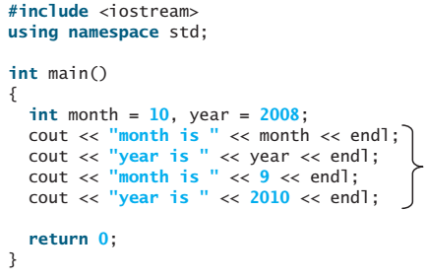
Inline Functions
compiler replaces each function call by actual function code.
Inline Function Code
Compiled Code
Inline functions are desirable for short functions but not for long ones that are called in multiple places in a program, because making multiple copies will dramatically increase the executable code size. For this reason, C++ allows the compilers to ignore the inline keyword if the function is too long. So, the inline keyword is merely a request; it is up to the compiler to decide whether to honor or ignore it.

Slide 32
Local, Global, and Static Local Variables
A variable must be declared before it can be used
The scope of a local variable starts from its declaration and continues to the end of the block that contains the variable
The scope of a global variable starts from its declaration and continues to the end of the program
A parameter is actually a local variable. The scope of a function parameter covers the entire function

Slide 33
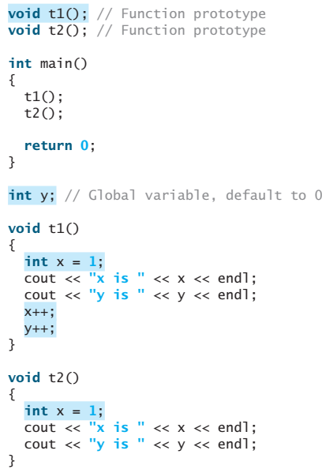
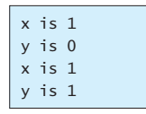
Local, Global, and Static Local Variables

Slide 34
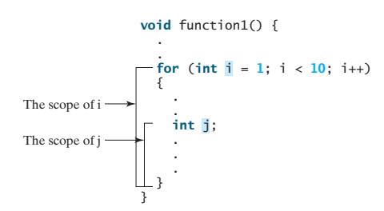
Local, Global, and Static Local Variables
It is tempting to declare a variable globally once and then use it in all functions. However, this is a bad practice, because modifying the global variables could lead to errors that are hard to debug. Avoid using global variables. Using global constants is permitted, since constants are never changed.
The Scope of Variables in a for Loop

Slide 35
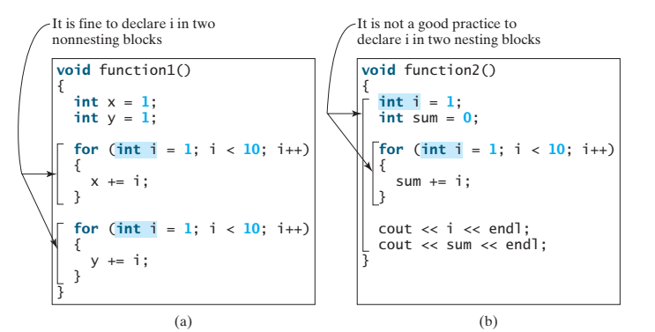
Local, Global, and Static Local Variables
A variable with same name can be declared multiple times in non-nesting blocks, but you should avoid declaring them in nesting blocks.

Slide 36
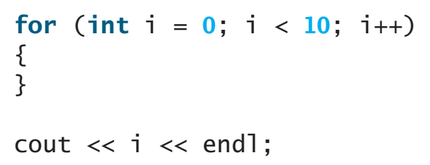
Local, Global, and Static Local Variables
Do not declare a variable inside a block and then attempt to use it outside the block.
A common mistake:
The last statement would cause a syntax error, because variable i is not defined outside the for loop (the scope of variable i).

Slide 37
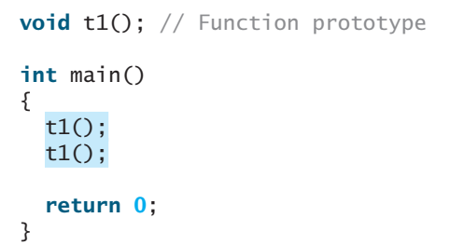
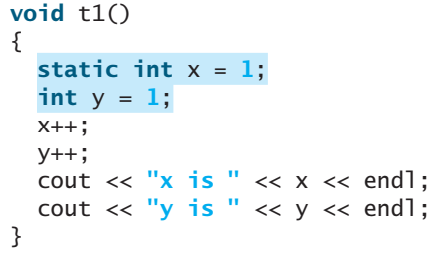
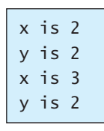
Local, Global, and Static Local Variables
Static Local Variables
After a function completes its execution, all its local variables are destroyed. These variables are also known as automatic variables. Sometimes it is desirable to retain the values stored in local variables so that they can be used in the next call. C++ allows you to declare static local variables. Static local variables are permanently allocated in the memory for the lifetime of the program.

Slide 38
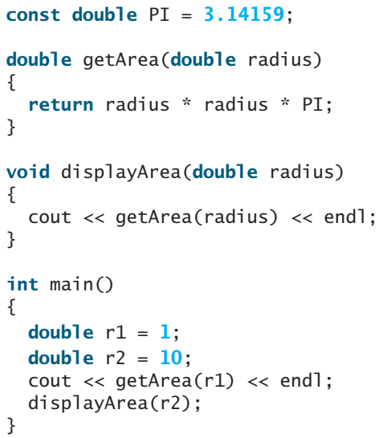
Local, Global, and Static Local Variables
Output?

Slide 39
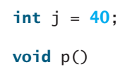
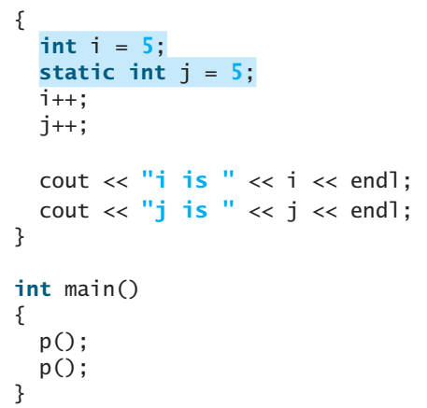
Local, Global, and Static Local Variables
Identify global variables, local variables, and static local variables in the following program. What will be the output of the code?

Slide 40
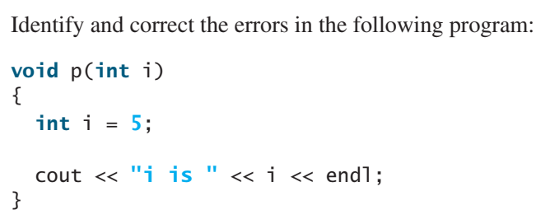
Local, Global, and Static Local Variables

Slide 41
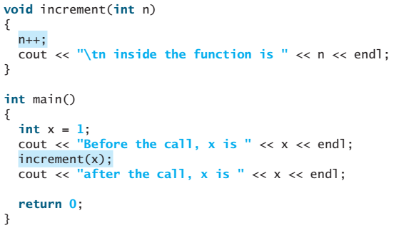
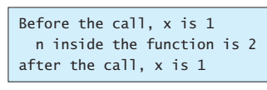
Passing Arguments by Reference
Parameters can be passed by reference, which makes the formal parameter an alias of the actual argument. Thus, changes made to the parameters inside the function also made to the arguments.

Slide 42
Continue…
Slides for remaining sections will be shared later

Slide 43
